Slide 1

Challenging the Status Quo of Diversification:
An Analysis of Returns by Asset Class

Slide 2
THE CHALLENGE
Diversified
vs.
Bonds
ETF
Real Estate
Stocks
Cryptocurrency

Slide 3
HISTORICAL ANALYSIS
• Jan 1 2018 – Nov 5 2021 •
Returns
Portfolios by Asset Class
Cumulative Returns
Average Annual Returns

Slide 4
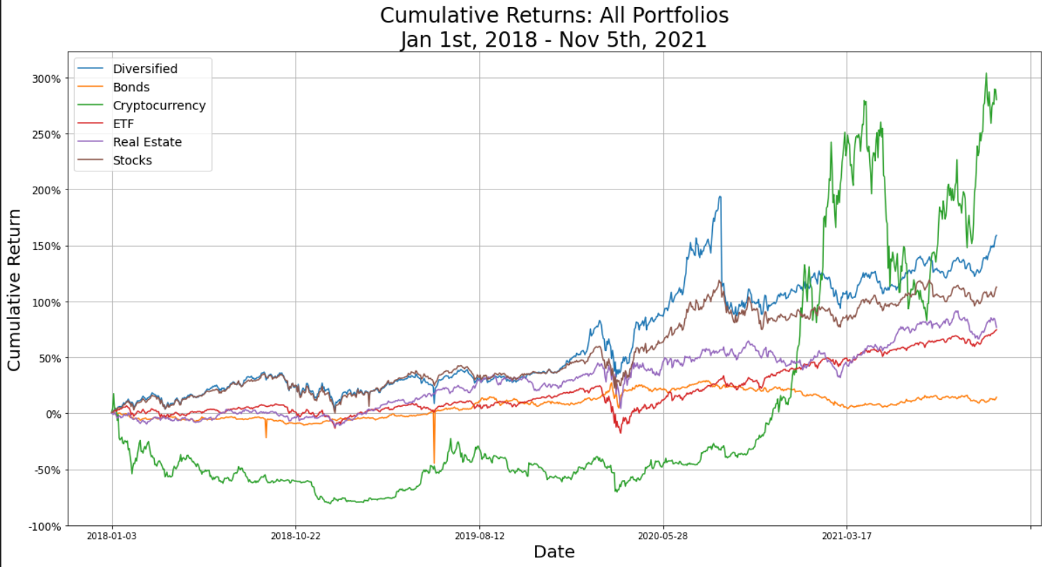
CUMULATIVE RETURNS
• Comparison Across Portfolios •

Slide 5
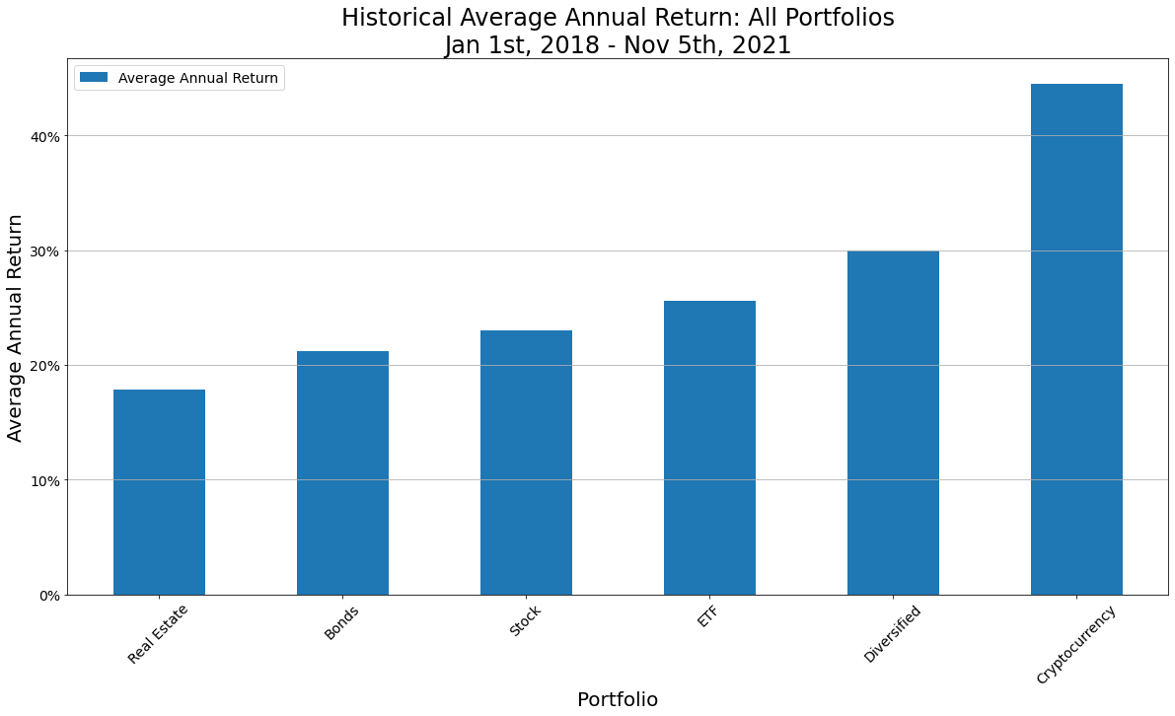
ANNUALIZED RETURNS
• Comparison Across Portfolios •

Slide 6
THE FUTURE
Monte Carlo Simulations
Portfolios by Asset Class
10 Year Forecast
1000 Simulations

Slide 7
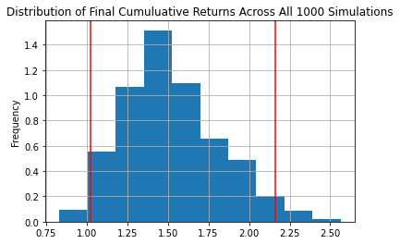
BONDS
• BLV • BND • EDV • VCLT • VGLT •
Monte Carlo Simulation 10 Years

Slide 8
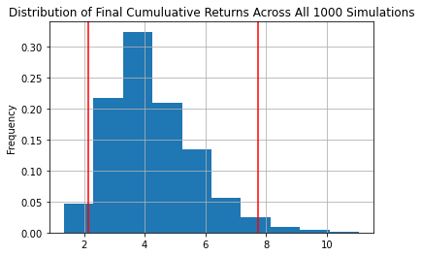
ETF
• EEM • VOO • VTI • VTV • VUG •
Monte Carlo Simulation 10 Years

Slide 9
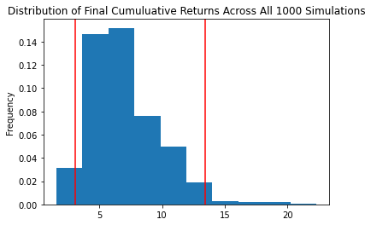
REAL ESTATE
• AMT • PLD • CCI • EQIX • PSA •
Monte Carlo Simulation 10 Years

Slide 10
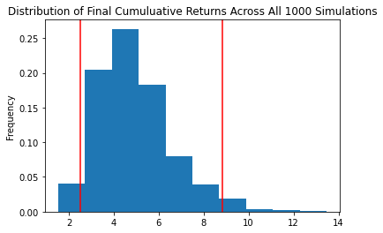
STOCKS
• FB • AMZN • AAPL • XOM • JPM •
• JNJ • HON • LIN • AMT • PG • NEE •
Monte Carlo Simulation 10 Years

Slide 11
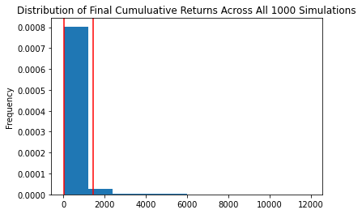
CRYPTO
• BTC • ETH • BNB • DASH • LTC •
Monte Carlo Simulation 10 Years

Slide 12
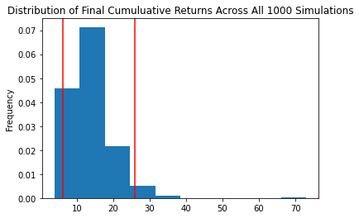
DIVERSIFIED
• VOO • MSFT • AAPL • BND • AMT •
• VUG • TSLA • AMZN • EDV • PLD •
Monte Carlo Simulation 10 Years

Slide 13
MONTE CARLO ANALYSES QUANTIFIED
What are the expected returns in 10 years?
95% confidence level
Initial investment of $10k
 | Bonds | ETF | Real Estate | Stocks | Crypto | Diversified
Lower Limit | $10,260 | $21,339 | $30,437 | $25,038 | $116,074 | $62,770
Upper Limit | $21,615 | $77,468 | $134,200 | $88,352 | $14,494,884 | $258,468

Slide 14
WHAT ABOUT RISK?
Sharpe Ratios
What is the risk-adjusted return?

Slide 15
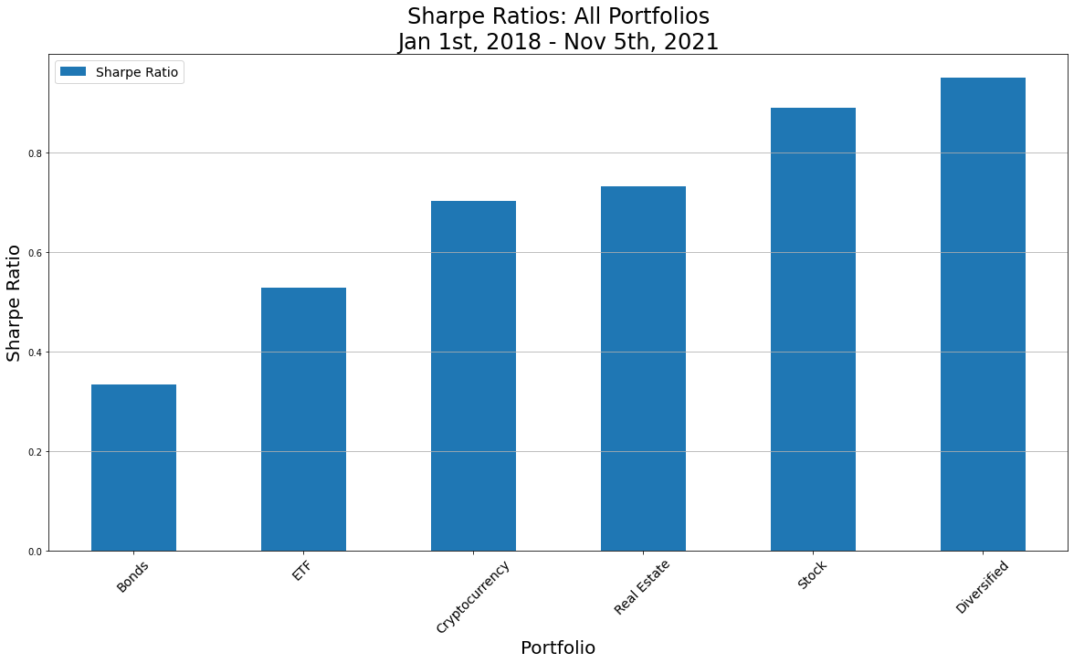
SHARPE RATIO
• Comparison Across Portfolios •
 | Bonds | ETF | Crypto | Real Est | Stock | Diversified
Annual Avg Return | 21.23% | 25.61% | 44.49% | 17.82% | 23.00% | 29.95%
Annual Std Dev | 63.58% | 48.54% | 63.38% | 24.33% | 25.87% | 31.53%

Slide 16

THE CHAMP
Diversified
vs.
Bonds
ETF
Real Estate
Stocks
Cryptocurrency

